Slide 1

USDA National Nutrient Analysis
By:
Kriti Srivastava

Slide 2
Introduction
Background
Healthy eating is an essential part of a healthy lifestyle.
Nutrition is the preeminent part of everyone's life starting from the new born baby to oldsters.
Gym can help shape physic of human but nutritions also play a vital role to achieve the goal.
The modern diet is mostly comprised of processed food and lacks essential nutrients that lead to : diabetes, hypertension, anemia, and obesity.
This study is to analyze different food products with the nutrients present and to know our food little better.
Data
In this study we are introducing the various approaches performed on USDA database containing the food and nutrition information.
Sample dataset contains: 8,618 rows , 6 Categorical variables, and 38 Continuous variables.

Slide 3
Literature Review
USDA’s National Food and Nutrient Analysis Program: Food Sampling
Pehrsson, P. R., Haytowitz, D. B., Holden, J. M., Perry, C. R., & Beckler, D. G. (2000). USDA’s National Food and Nutrient Analysis Program: Food Sampling. Journal of Food Composition and Analysis, 13(4), 379–389. https://doi.org/10.1006/jfca.1999.0867
Dietary patterns derived from principal component- and k-means cluster analysis: Long-term association with coronary heart disease and stroke.
Stricker, M., Onland-Moret, N., Boer, J., Schouw, Y. V., Verschuren, W., May, A., . . . Beulens, J. (2013). Dietary patterns derived from principal component- and k-means cluster analysis: Long-term association with coronary heart disease and stroke. Nutrition, Metabolism and Cardiovascular Diseases, 23(3), 250-256. https://doi.org/10.1016/j.numecd.2012.02.006
Analysis of patterns of food intake in nutritional epidemiology: Food classification in principal components analysis and the subsequent impact on estimates for endometrial cancer.
McCann, S., Marshall, J., Brasure, J., Graham, S., & Freudenheim, J. (2001). Analysis of patterns of food intake in nutritional epidemiology: Food classification in principal components analysis and the subsequent impact on estimates for endometrial cancer. Public Health Nutrition, 4(5), 989-997. doi:10.1079/PHN2001168

Slide 4
Research questions and Methods
Is it possible to explain the food products based on classification of their nutrients description?
Method: Principal Component Analysis
If yes, is there any relationship between the nutrients ?
Method: Canonical correlation analysis

Slide 5
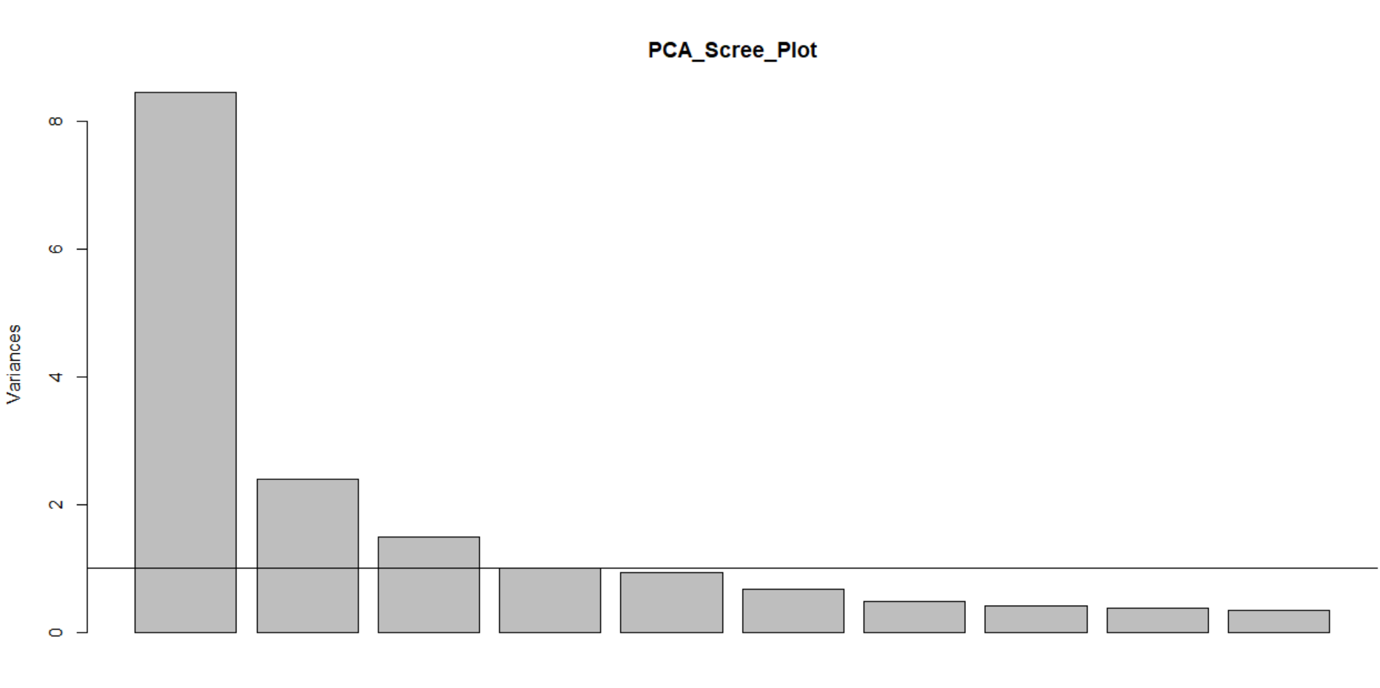
Discussion And Results - Principal Component Analysis
Explains the food products based on classification of their nutrients description
Perform dimension reduction: for the next procedure i.e. Canonical Correlation Analysis on the resultant components of PCA Analysis
The scree plot shows three components that explains most of the variance.
Assumptions for factorability
KMO Test: Overall MSA = 0.89
Bartlett's Test of Sphericity: p-value < 2.22e-16 (very small which means we have enough variance in the data so we can perform factor analysis)
Reliability Analysis using Cronbach's Alpha: raw_alpha = 0.92 Hence, The sample data is good to perform PCA.

Slide 6
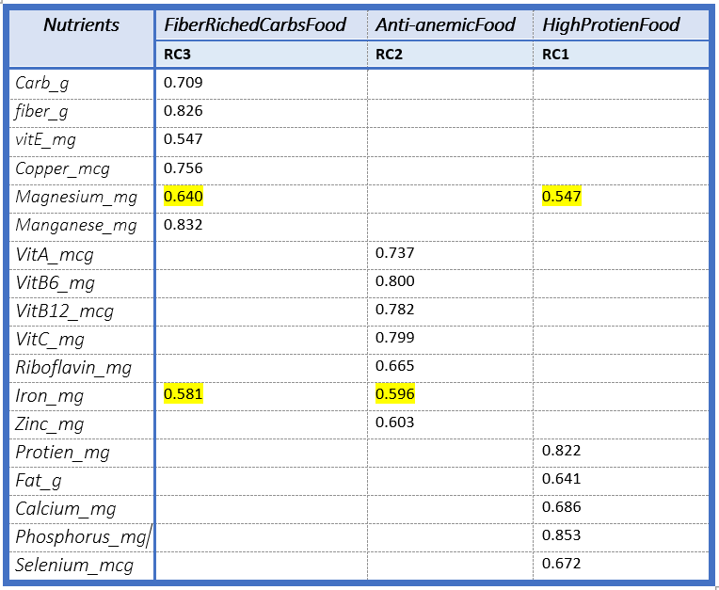
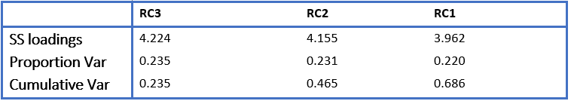
Discussion And Results - Principal Component Analysis
Rotate="varimax", nfactors=3, cutoff=.48
PCA produced 3 components:
RC3 : rich in fiber, Vitamin E as well as carbohydrates. Therefore, this component explains the sets of FiberRichedCarbsFood variables.
RC2: rich in Vitamins, iron, and zinc.
Foods rich in vitamin C helps in the absorption of iron
Good for anemic people therefore, this component explains the sets of Anti-AnemicFood variables.
RC1: rich in protein and fats therefore, this component explains the sets of HighProteinFood variables.

Slide 7
Discussion And Results - Factor Analysis
•Factor analysis applied on the USDA National Nutrient dataset having total 45 columns and 8618 entries.
•Tests:
▪Cronbach's alpha : 0.54
▪Kaiser-Meyer-Olkin (KMO) Test for Sampling Adequacy : 0.64
▪Bartlett's Test of Sphericity : chi-square: 120430.831
p-value < 0.001

Slide 8
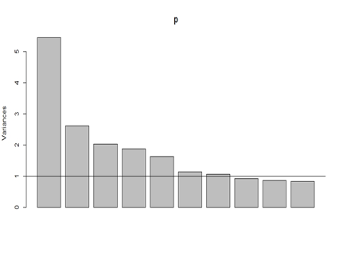
Discussion And Results - Factor Analysis
Scree plot. A scree plot is a plot of the Eigenvalues against the number of factors in order of extraction.

Slide 9
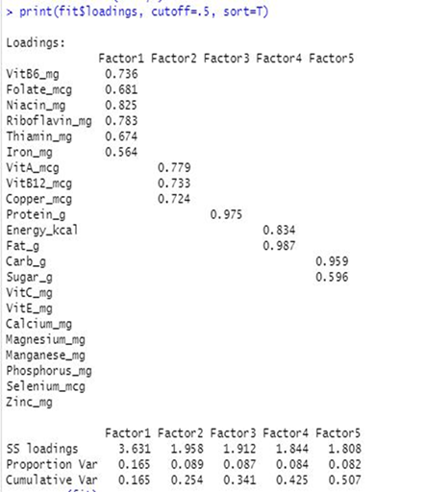
Factor Matrix
Cutoff is 0.55
Displayed matrix consisted of 5 Factors.
•Dietary
•Minerals
•Aminos
•Strength
•Disaccharides

Slide 10
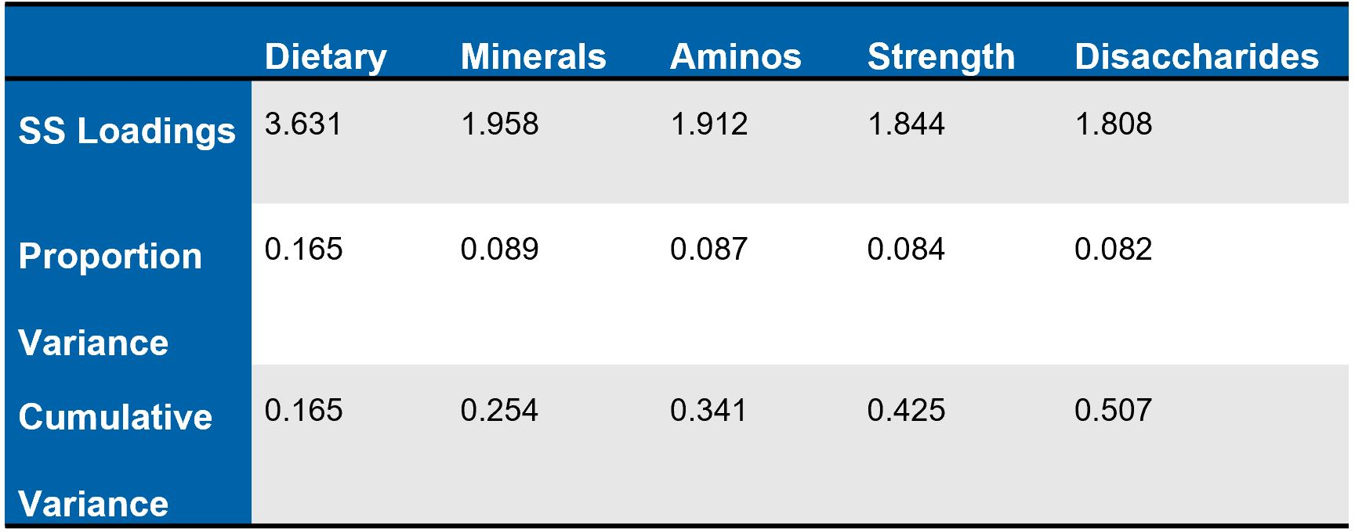
Factors Contributing Variance

Slide 11
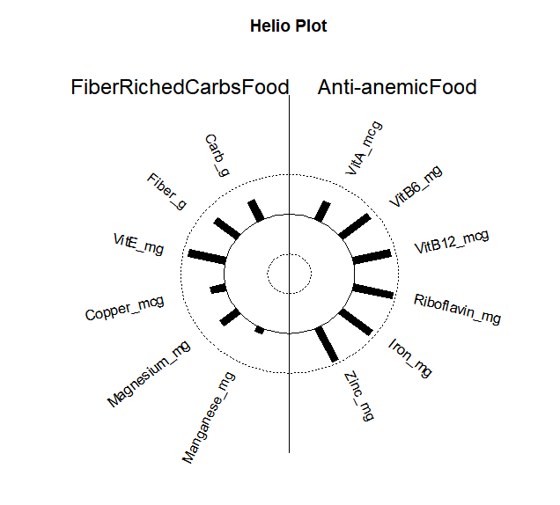
Discussion And Results - Canonical Correlation Analysis
This makes VitE_mg and Fiber_g the most important and influential variables for its covariate FiberRichedCarbsFood.
VitB6_mcg, VitB12_mcg, Riboflavin_mg, Iron_mg , and Zinc_mg are the most important and influential variables for its covariate Anti-Anemic Food.
Also, the variables seem to have positive correlation among themselves.

Slide 12
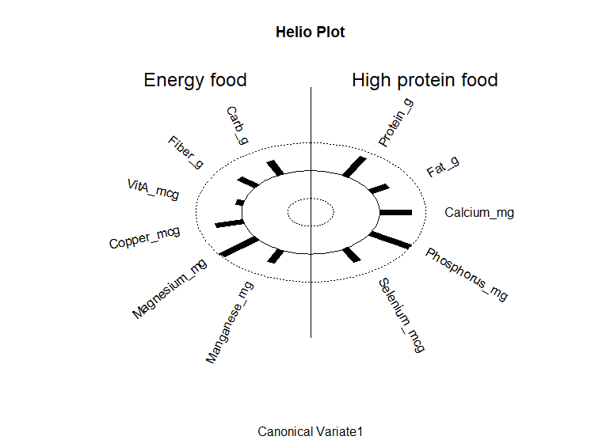
Discussion and Results - Canonical Correlation Analysis
Magnesium is the most important influential variable for the covariate Energy food or fiber rich carb food (RC3).
Phosphorus is the most important influential variable for the covariate high protein food(RC1).

Slide 13
Future Works
This study is done on the outdated version SD27 of USDA National Nutrient Database.
This study only shows how the food products are rich or deficits in different good components however, it does not cluster the food products or labels the good product into categories on the basis of their nutrient factors.
This study does not include the relationship between the components produced from the factor analysis which can be done in the future analysis.

Slide 14
Limitations
The study do not identifying the amount / portion of the nutrients are needed in our diet.
Absence of data to study the estimation of the risk of disease with nutrient patterns.

Slide 15
Conclusion
Depending upon the need of the individual, it is possible to focus on food product that are rich in specific set of nutrient:
Fiber - riched Carbohydrates : Nutritious carbohydrate foods are rich source of fiber, as fiber itself is a form of carbohydrate. A high-fiber diet may protect against conditions like tips and heart disease.
Anti-anemic nutrient : includes high content of iron with vitamin C and zinc. anti-anemic diet is good for people struggling with anemia.
High-Protein : high protein diet includes proteins and good fats that is good for building muscles and are very important especially for athletes.

Slide 16
Conclusion
The nutrients pattern are related to each other :
Fiber- rich Carbohydrates increases with the increase in Anti-anemic food nutrients also increases.
Similarly, as Fiber- rich Carbohydrates increases in the food items, high protein nutrients are also observed to be increased.

Slide 17
References
Pehrsson, P. R., Haytowitz, D. B., Holden, J. M., Perry, C. R., & Beckler, D. G. (2000). USDA’s National Food and Nutrient Analysis Program: Food Sampling. Journal of Food Composition and Analysis, 13(4), 379–389. https://doi.org/10.1006/jfca.1999.0867
US Department of Agriculture, Agricultural Research Service, Nutrient Data Laboratory. USDA National Nutrient Database for Standard Reference, Release 28 (Slightly revised). Version Current: May 2016. Internet: http://www.ars.usda.gov/ba/bhnrc/ndl
McCann, S., Marshall, J., Brasure, J., Graham, S., & Freudenheim, J. (2001). Analysis of patterns of food intake in nutritional epidemiology: Food classification in principal components analysis and the subsequent impact on estimates for endometrial cancer. Public Health Nutrition, 4(5), 989-997. doi:10.1079/PHN2001168
Stricker, M., Onland-Moret, N., Boer, J., Schouw, Y. V., Verschuren, W., May, A., . . . Beulens, J. (2013). Dietary patterns derived from principal component- and k-means cluster analysis: Long-term association with coronary heart disease and stroke. Nutrition, Metabolism and Cardiovascular Diseases, 23(3), 250-256. doi:10.1016/j.numecd.2012.02.006Uusitalo, L., Nevalainen, J., Salminen, I., Ovaskainen, M., Kronberg-Kippilä, C., Ahonen, S., . . . Virtanen, S. M. (2011). Fatty acids in serum and diet - a canonical correlation analysis among toddlers. Maternal & Child Nutrition, 9(3), 381-395. doi:10.1111/j.1740-8709.2011.00374.x https://onlinelibrary.wiley.com/doi/epdf/10.1111/j.1740-8709.2011.00374.x

